Slide 1
Global Warming and Energy Consumption

Slide 2
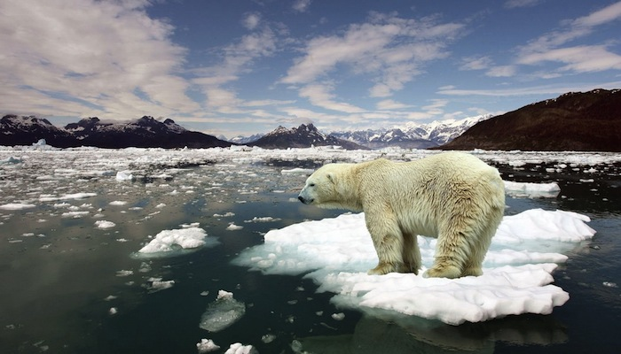

Slide 3
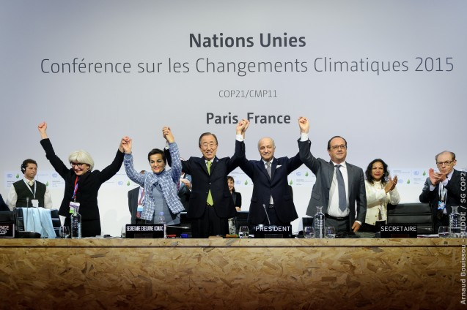
Paris Climate Accord
Goal: Keep warming to less than +2ºC

Slide 4
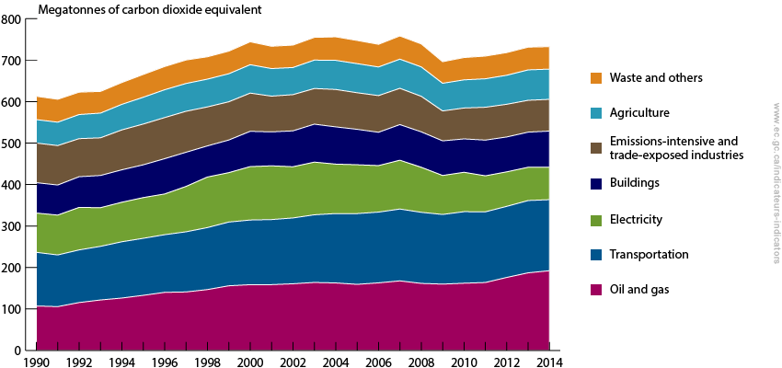
Canada’s Commitment
Canada has pledged to, by 2030, cut its emissions by 30 per cent from 2005 levels.

Slide 5
How is Canada Doing?
Start Your Investigation!

Slide 6
We Need Solutions!
Work together to find ways to reduce GHG emissions
We need scientists, engineers, economists, designers, business people, politicians, to work as a team

Slide 7
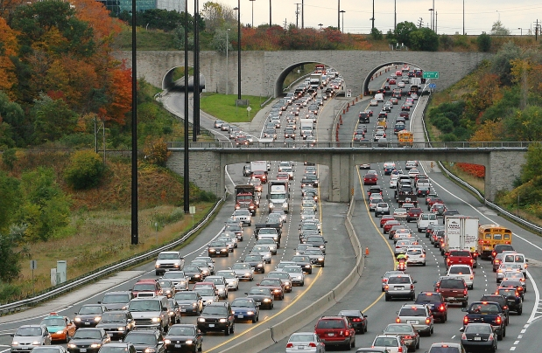
Passenger Vehicle GHG Emissions

Slide 8
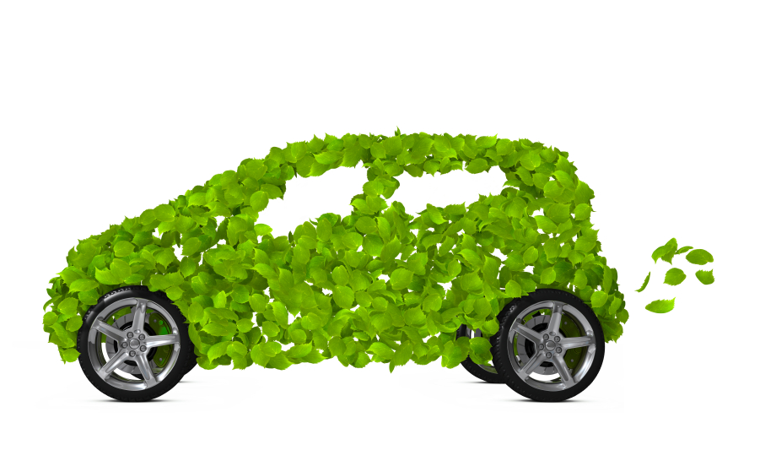
Green Vehicle Project

Slide 9
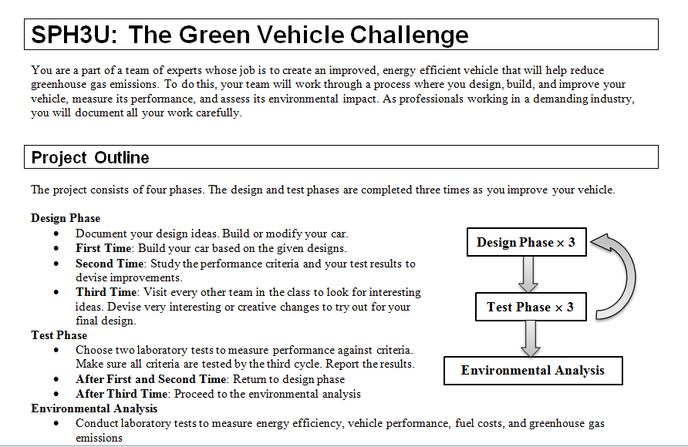
Find Your Project Sheet

Slide 10

You are a design team!

Slide 11
Goals
Design a vehicle that has a:
High Performance
Hit as many performance criteria as possible
Reduced Environmental Impact
Reduce fuel consumption
Reduce greenhouse gas (GHG) emissions

Slide 12

Choose Vehicle Class
Passenger Car

Slide 13
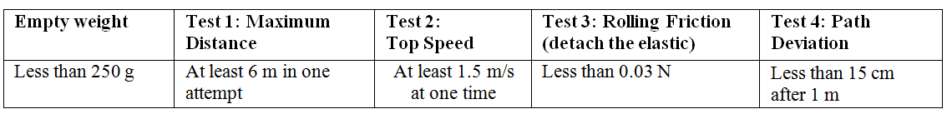
Performance Criteria

Slide 14
You are a design team
Design and build an elastic band-powered vehicle
Test the vehicle against the performance criteria
Analyze its environmental impact
x3

Slide 15
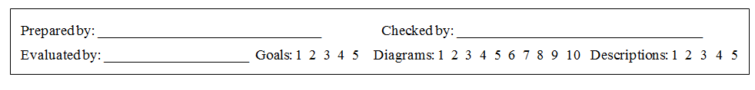
Assessment
Writer: Each page has one writer
Checker: check page and make improvements. Use a coloured pen. Sign the page, certifying that it is high-quality, reliable work.
Evaluator: Use a rubric to provide a numerical evaluation of the quality of the work at the bottom of the page.

Slide 16
High Quality Work!
Professional work and trade work does not tolerate poor-quality work
Poor-quality work has consequences that are not experienced in school

Slide 17
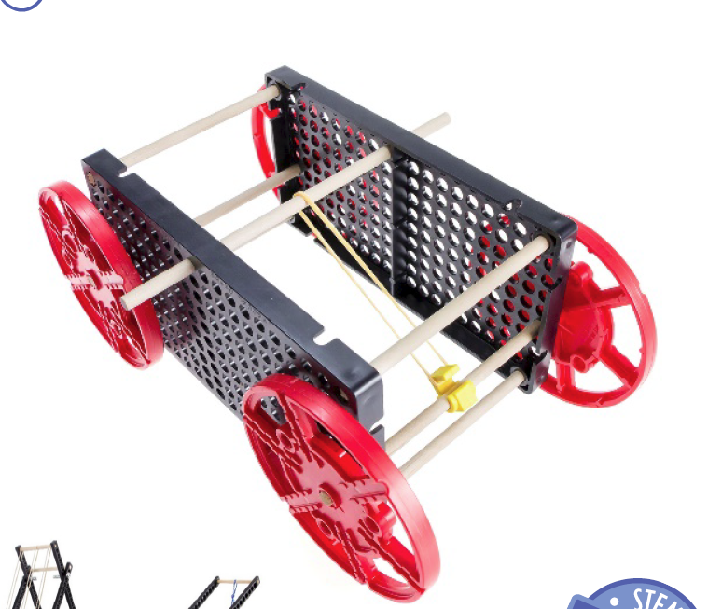
Design Your Vehicle!
Two side panels
Elastic Band
Four Wheels
Elastic Hook

Slide 18
Material Use
Only take materials you need
We will reuse any useful left-over pieces
Share the tools, return them right away
Cut wood dowels carefully! Don’t let the pieces fly!
Please tidy tables at the end of class
Store completed work in the cabinet at the back

Slide 19
Ideas

Slide 20
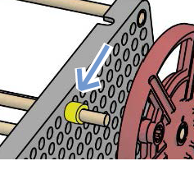
Slide Stoppers

Slide 21
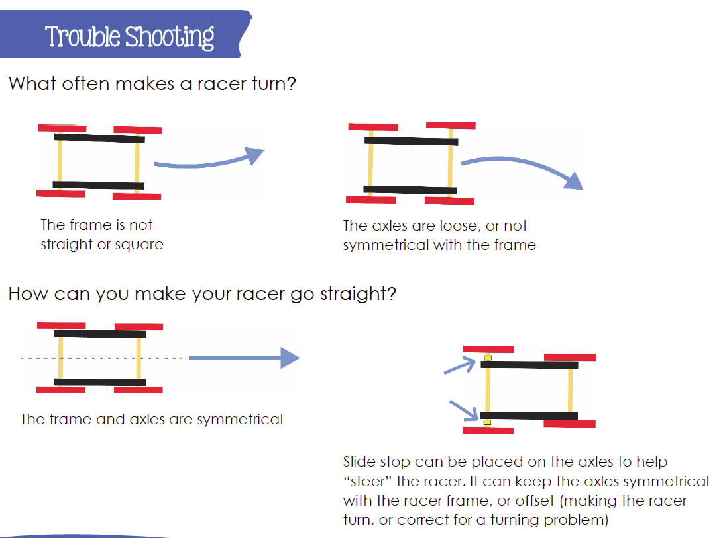
Trouble Shooting

Slide 22
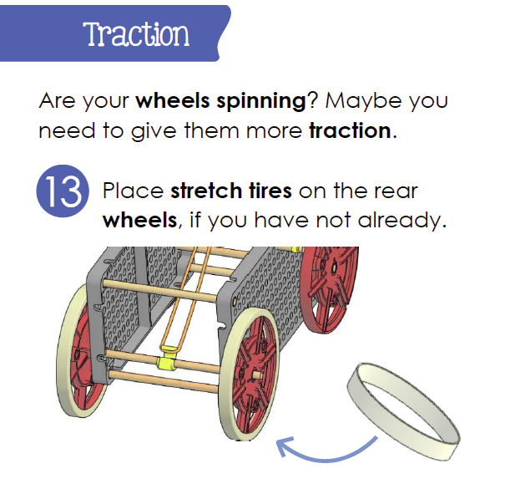

Slide 23
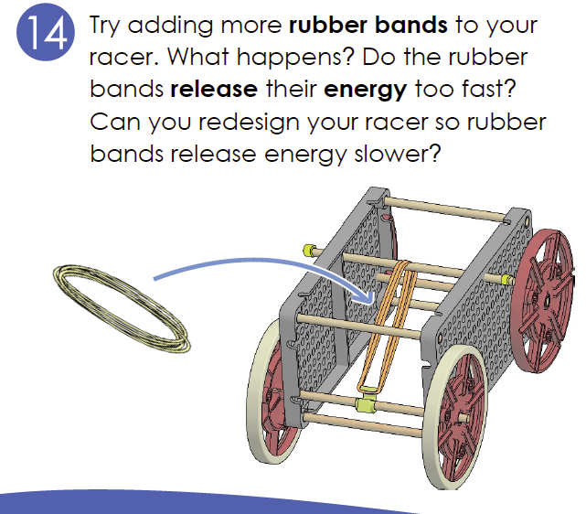

Slide 25
Today’s Updates
Project will continue on Monday
Full report is due Tuesday, start of class
You should have cycle #2 complete today!
Get started!

Slide 26
Velocity Analysis Capstone

